Slide 1
DIABLO: Using FPGAs to Simulate Novel Datacenter Network Architectures at Scale
Zhangxi Tan, Krste Asanovic, David Patterson
June 2013

Slide 2
Agenda
Motivation
Computer System Simulation Methodology
DIABLO: Datacenter-in-Box at Low Cost
Case Studies
Experience and Lessons learned

Slide 3
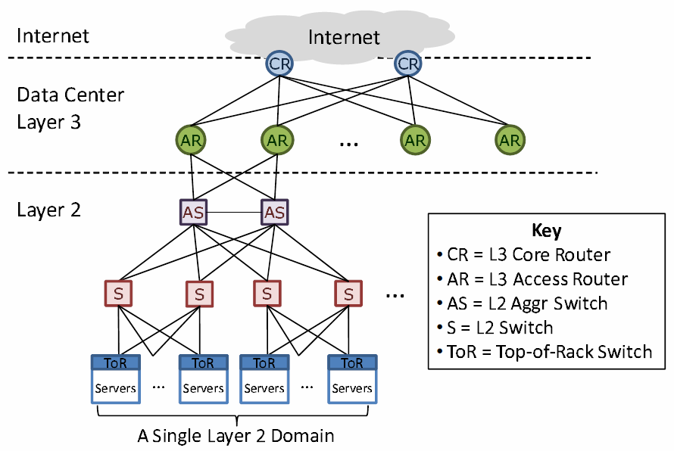
Datacenter Network Architecture Overview
Conventional datacenter network (Cisco’s perspective)
Figure from “VL2: A Scalable and Flexible Data Center Network”

Slide 4
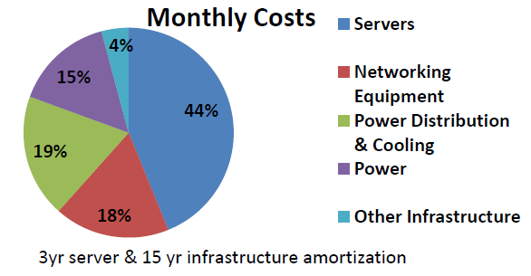
Observations
Network infrastructure is the “SUV of datacenter”
  18% monthly cost (3rd largest cost)
  Large switches/routers are expensive and unreliable
  Important for many optimizations:
    Improving server utilization
    Supporting data intensive map-reduce jobs
Source: James Hamilton, Data Center Networks Are in my Way, Stanford Oct 2009

Slide 5
Advances in Datacenter Networking
Many new network architectures proposed recently focusing on new switch designs
  Research : VL2/monsoon (MSR), Portland (UCSD), Dcell/Bcube (MSRA), Policy-aware switching layer (UCB), Nox (UCB), Thacker’s container network (MSR-SVC)
  Product : Google g-switch, Facebook 100 Gbps Ethernet and etc.
Different observations lead to many distinct design features
  Switch designs
    Packet buffer micro-architectures
    Programmable flow tables
  Application and protocols
    ECN support

Slide 6
Evaluation Limitations
The methodology to evaluate new datacenter network architectures has been largely ignored
  Scale is way smaller than real datacenter network
    <100 nodes, most of testbeds < 20 nodes
  Synthetic programs and benchmarks
    Datacenter Programs: Web search, email, map/reduce
  Off-the-shelf switches architectural details are proprietary
    Limited architectural design space configurations: E.g. change link delays, buffer size and etc.
How to enable network architecture innovation at scale without first building a large datacenter?

Slide 7
A wish list of networking evaluations
Evaluating networking designs is hard
  Datacenter scale at O(10,000) -> need scale
  Switch architectures are massively paralleled -> need performance
    Large switches has 48~96 ports, 1K~4K flow tables/port. 100~200 concurrent events per clock cycles
  Nanosecond time scale -> need accuracy
    Transmit a 64B packet on 10 Gbps Ethernet only takes ~50ns, comparable to DRAM access! Many fine-grained synchronization in simulation
  Run production software -> need extensive application logic

Slide 8
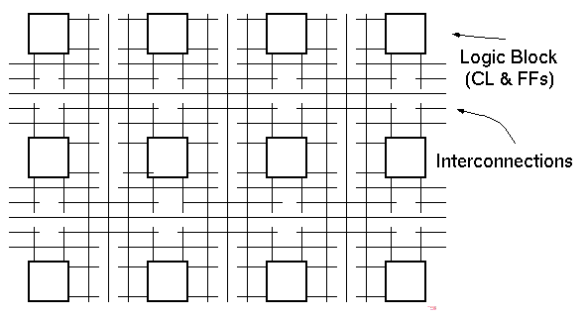
My proposal
Use Field Programmable Gate Array (FPGAs)
DIABLO: Datacenter-in-Box at Low Cost
  Abstracted execution-driven performance models
  Cost ~$12 per node.

Slide 9
Agenda
Motivation
Computer System Simulation Methodology
DIABLO: Datacenter-in-Box at Low Cost
Case Studies
Experience and Lessons learned
Future Directions

Slide 10
Computer System Simulations
Terminology
  Host vs. Target
    Target: Systems being simulated, e.g. servers and switches
    Host: The platform on which the simulator runs, e.g. FPGAs
Taxonomy
  Software Architecture Model Execution (SAME) vs FPGA Architecture Execution (FAME)
A case for FAME: FPGA architecture model execution, ISCA’10

Slide 11
Software Architecture Model Execution (SAME)
 | Median Instructions Simulated/ Benchmark | Median #Cores | Median Instructions Simulated/ Core
ISCA 1998 | 267M | 1 | 267M
ISCA 2008 | 825M | 16 | 100M
Issues:
  Dramatically shorter simulation time! (~10ms)
    Datacenter: O(100) seconds or more
  Unrealistic models, e.g. infinite fast CPUs

Slide 12
FPGA Architecture Execution (FAME)
FAME: Simulators built on FPGAs
  Not FPGA computers
  Not FPGA accelerators
Three FAME dimensions:
  Direct vs Decoupled
    Direct: Target cycles = host cycles
    Decoupled: Decouple host cycles from target cycles use models for timing accuracy
  Full RTL vs Abstracted
    Full RTL: resource inefficient on FPGAs
    Abstracted: modeled RTL with FPGA friendly structures
  Single vs Multithreaded host

Slide 13
Host multithreading
Example: simulating four independent CPUs
Target Model
CPU0
CPU1
CPU2
CPU3
Functional CPU model on FPGA
PC
1
X
PC
1
GPR1
ALU
I$
IR
DE
GPR1
PC
1
GPR1
PC
1
GPR1
D$
Y
+1
Thread
Select
2
2
2

Slide 14
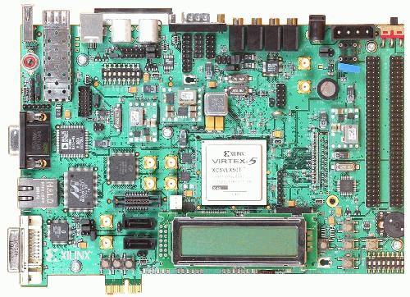
RAMP Gold: A Multithreaded FAME Simulator
Rapid accurate simulation of manycore architectural ideas using FPGAs
Initial version models 64 cores of SPARC v8 with shared memory system on $750 board
Hardware FPU, MMU, boots OS.
 | Cost | Performance (MIPS) | Simulations per day
Simics (SAME) | $2,000 | 0.1 - 1 | 1
RAMP Gold (FAME) | $2,000 + $750 | 50 - 100 | 250

Slide 15
Agenda
Motivation
Computer System Simulation Methodology
DIABLO: Datacenter-in-Box at Low Cost
Case Studies
Experience and Lessons learned

Slide 16
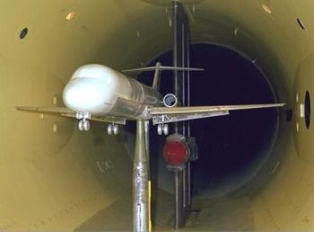
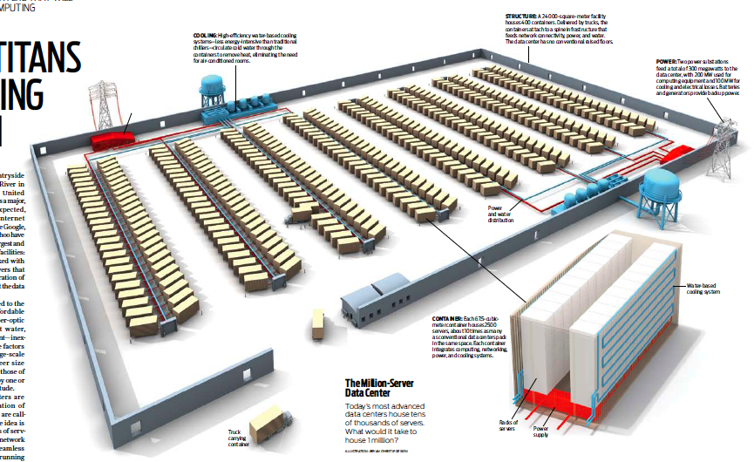
DIABLO Overview
Build a “wind tunnel” for datacenter network using FPGAs
  Simulate O(10,000) nodes: each is capable of running real software
  Simulate O(1,000) datacenter switches (all levels) with detail and accurate timing
  Simulate O(100) seconds in target
  Runtime configurable architectural parameters (link speed/latency, host speed)
  Built with the FAME technology
Executing real instructions, moving real bytes in the network!
Notes:
Bee3 overview

Slide 17
DIABLO Models
Server models
  Built on top of RAMP Gold : SPARC v8 ISA, 250x faster than SAME
  Run full Linux 2.6 with a fixed CPI timing model
Switch models
  Two types: circuit-switching and packet-switching
  Abstracted models focusing on switch buffer configurations
    Model after Cisco Nexsus switch + a Broadcom patent
NIC models
  Scather/gather DMA + Zero-copy drivers
  NAPI polling support

Slide 18
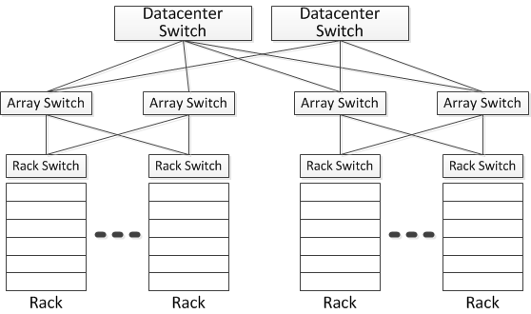
Mapping a datacenter to FPGAs
Modularized single-FPGA designs: two types of FPGAs
  Connecting multiple FPGAs using multi-gigabit transceivers according to physical topology
  128 servers in 4 racks per FPGA; one array/DC switch per FPGA

Slide 19
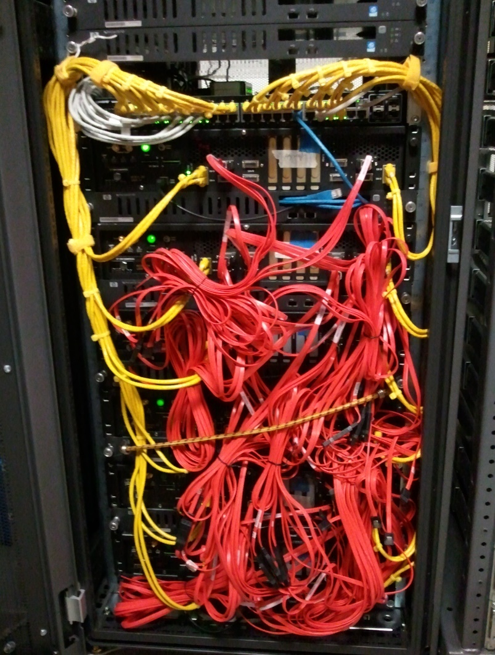
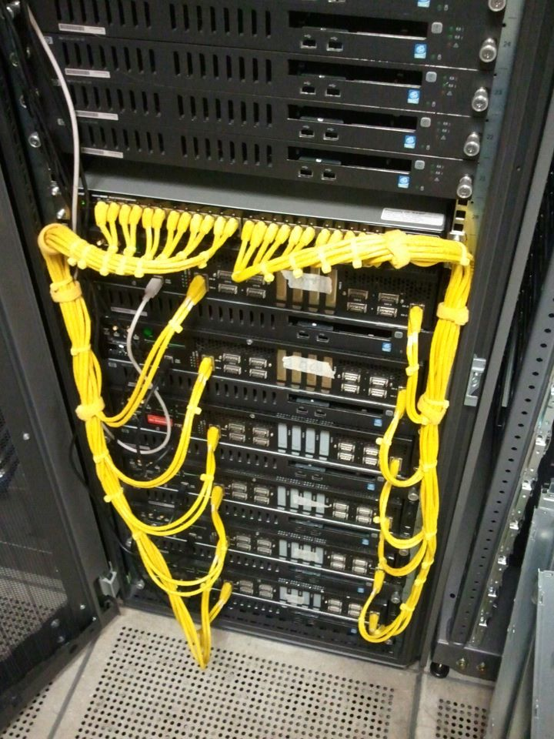
DIABLO Cluster Prototype
6 BEE3 boards of 24 Xilinx Virtex5 FPGAs
  Physical characters:
    Memory: 384 GB (128 MB/node), peak bandwidth 180 GB/s
    Connected with SERDES @ 2.5 Gbps
    Host control bandwidth: 24 x 1 Gbps control bandwidth to the switch
    Active power: ~1.2 kwatt
  Simulation capacity
    3,072 simulated servers in 96 simulated racks, 96 simulated switches
    8.4 B instructions / second

Slide 20
Physical Implementation
Server model
Rack Switch
0
Server model
1
Model
&
0
1
Full-customized FPGA designs (no 3rd party IPs except FPU)
  ~90% BRAMs, 95% LUTs
  90 MHz / 180 MHz on Xilinx Virtex 5 LX155T (2007 FPGA)
Building blocks on FPGAs
  4 server pipelines of 128/256 nodes + 4 switches/NICs
  1~5, 2.5 Gbps transceivers
  Two DRAM channels of 16 GB DRAM
Host DRAM
NIC Model
Partition A
0
&
1
Tranceiver to
Text
Switch FPGA
Host DRAM
Partition B
Rack Switch
Model
2
&
3
Server model
NIC Model
2
Server model
3
2
&
3
Die photo of FPGAs simulating server racks

Slide 21
Simulator Scaling for a 10,000 system
 | RAMP Gold Pipelines per chip | Simulated Servers per chip | Total FPGAs
2007 FPGAs (65nm Virtex 5) | 4 | 128 | 88 (22 BEE3s)
2013 FPGAs (28nm Virtex 7) | 32 | 1024 | 12
Total cost @ 2013: ~$120K
  Board cost: $5,000 * 12 = $60,000
  DRAM cost: $600 * 8 * 12 = $57,000

Slide 22
Agenda
Motivation
Computer System Simulation Methodology
DIABLO: Datacenter-in-Box at Low Cost
Case Studies
Experience and Lessons learned

Slide 23
Case studies 1 – Model a novel Circuit-Switching network
An ATM-like circuit switching network for datacenter containers
Full-implementation of all switches, prototyped within 3 months with DIABLO
Run Hand coded Dryad Terasort kernel with device drivers
Successes:
  Identify bottlenecks in circuit setup/tear down in the SW design
  Emphasis on software processing: a lossless HW design, but packet losses due to inefficient server processing
*A data center network using FPGAs
Chuck Thacker, MSR Silicon Valley
23

Slide 24
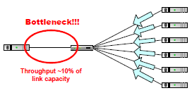
Case Study 2 – Reproducing the Classic TCP Incast Throughput collapse
A TCP throughput collapse that occurs as the number of servers sending data to a client increases past the ability of an Ethernet switch to buffer packets.
  Safe and Effective Fine-grained TCP Retransmissions for Datacenter Communication. V. Vasudevan. and et al. SIGCOMM’09
  Original experiments on NS/2 and small scale clusters (<20 machines)
  “Conclusions”: switch buffers are small, and TCP retransmission time out is too long

Slide 25
Reproducing TCP incast on DIABLO
Small request block size (256 KB) on a shallow buffer 1 Gbps switch (4KB per port)
  Unmodified code from a networking research group from Stanford
  Results seems to be consistent varying host CPU performance, OS syscall used

Slide 26
Scaling TCP incast on DIABLO
epoll
pthread
Scale to 10 Gbps switch, 16 KB port buffers, 4 MB request size
Host processing performance and syscall usage have huge impacts on application performance

Slide 27
Summaries on Case 2
Reproduce the TCP incast datacenter problem
System performance bottlenecks could shift at a different scale!
Simulating OS and computations is important

Slide 28
Case study 3 – running memcached service
Popular distributed key-value store app, used by many large websites: Facebook, twitter, Flickr,…
Unmodified memcached + clients in libmemcached
  Clients generate traffic based on Facebook statistic (SIGMETRICS’12)

Slide 29
Validations
16-node cluster 3 GHz Xeon + 16 port Asante IntraCore 35516-T switch
  Physical hardware configuration: two servers + 1 ~ 14 clients
  Software configurations
    Server protocols: TCP/UDP
    Server worker threads: 4 (default), 8
Simulated server : single-core @ 4 GHz fixed CPI
  Different ISA, different CPU performance

Slide 30
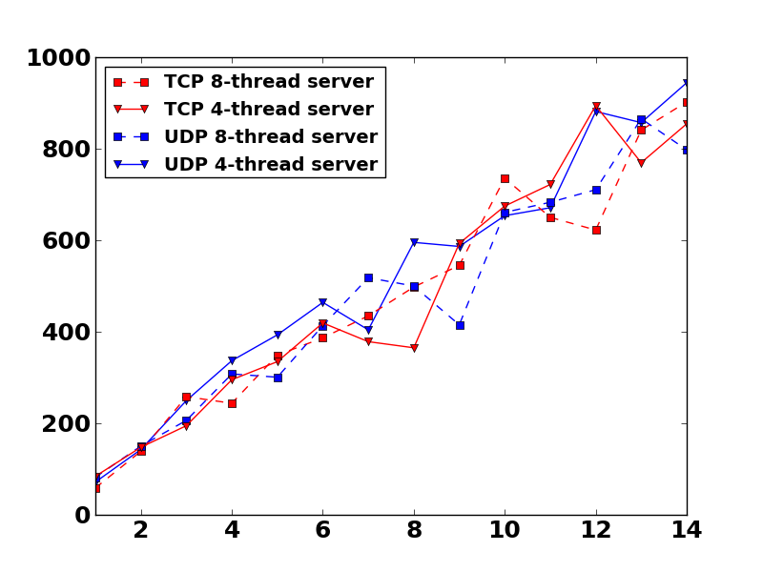
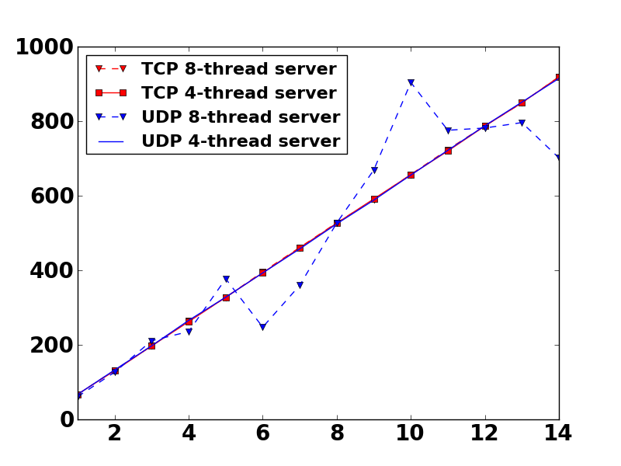
Validation: Server throughput
DIABLO
Real Cluster
KB/s
# of clients
# of clients
Absolute values are close

Slide 31
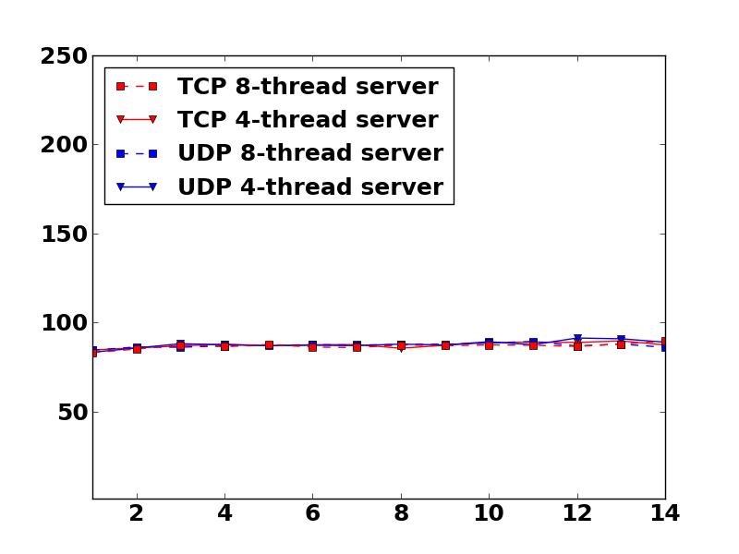
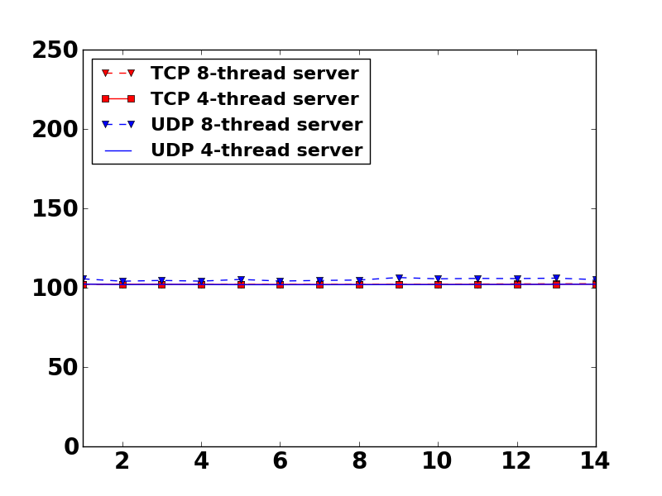
Validation: Client latencies
DIABLO
Real Cluster
Microsecond
# of clients
# of clients
Similar trend as throughput, but absolute value is different due to different network hardware

Slide 32
Experiments at scale
Simulate up to the 2,000-node scale
  1 Gbps interconnect : 1~1.5us port-port latency
  10 Gbps interconnect: 100~150ns port-port latency
Scaling the server/client configuration
  Maintain the server/client ratio: 2 per rack
  All servers load are moderate, ~35% CPU utilization. No packet loss

Slide 33
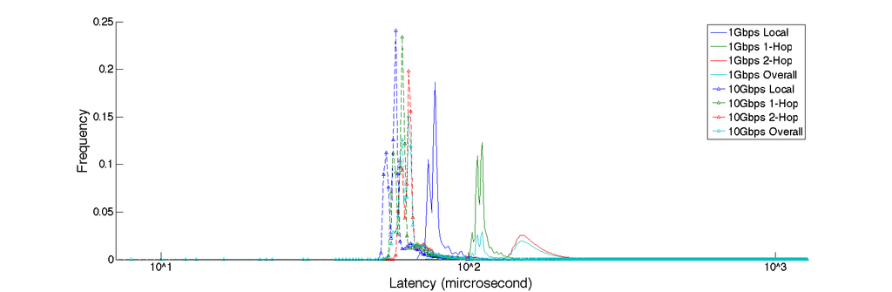
Reproducing the latency long tail at the 2,000-node scale
10 Gbps
1 Gbps
Most of request finish quickly, but some 2 orders of magnitude slower
More switches -> greater latency variations
Low-latency 10Gbps switches improve access latency but only 2x
  Luiz Barroso “entering the teenage decade in warehouse-scale computing” FCRC’11

Slide 34
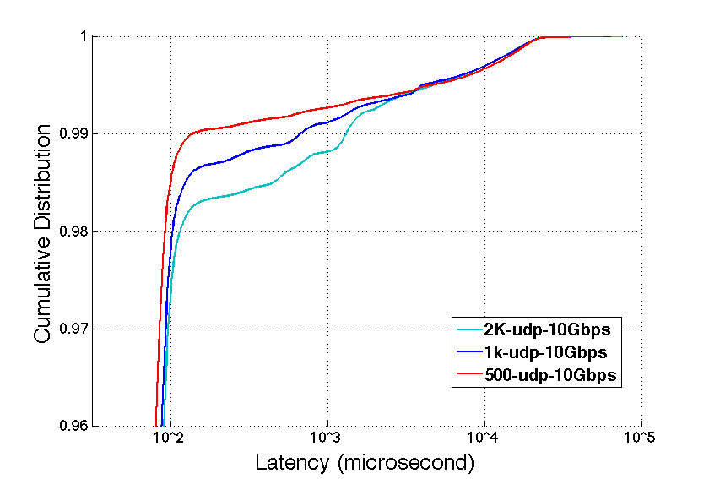
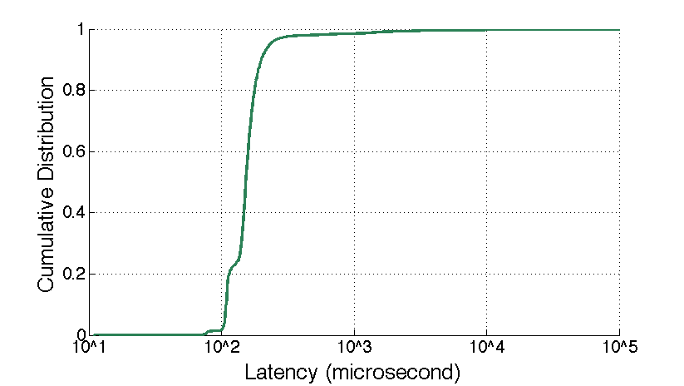
Impact of system scales on the “long tail”
More nodes -> longer tail

Slide 35
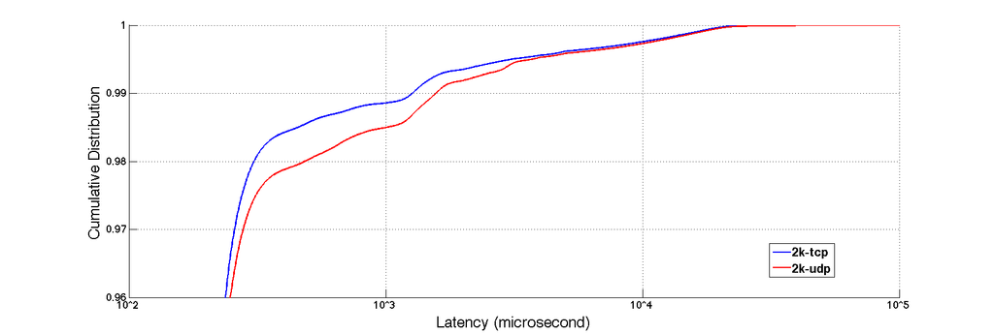
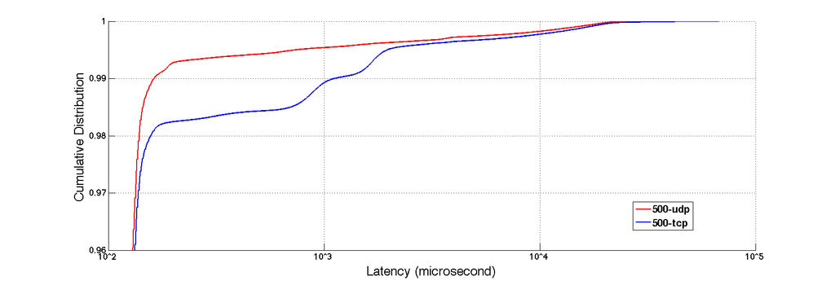
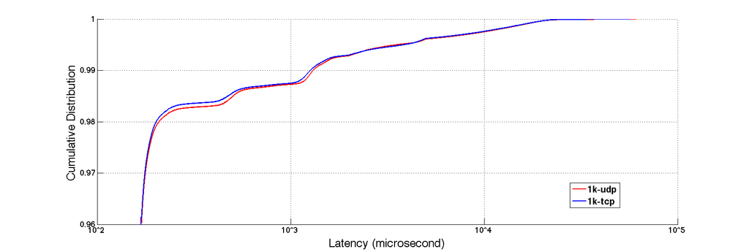
O(100) vs O(1,000) at the ‘tail’
No significant difference
TCP slightly better
UDP better
TCP better
Which protocol is better for 1 Gbps interconnect?

Slide 36
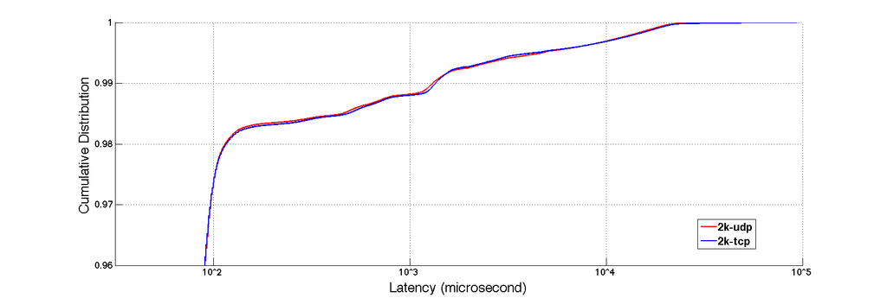
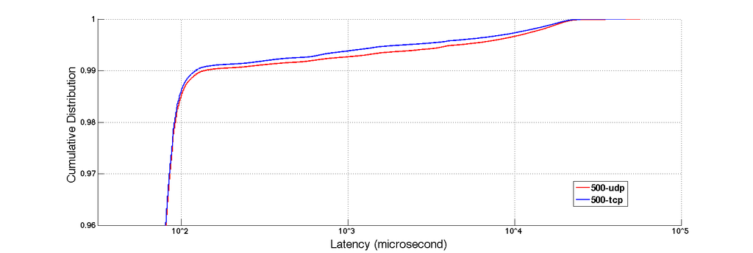
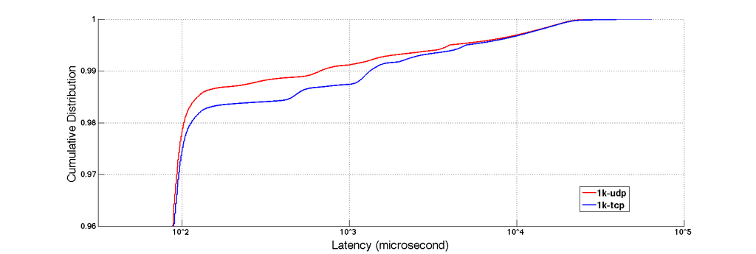
O(100) vs O(1,000) @10 Gbps
TCP is slightly better
UDP better
Par!
Is TCP a better choice again at large scales?

Slide 37
Other issues at scale
TCP does not consume more memory than UDP when server load is well-balanced
Do we really need a fancy transport protocol?
  Vanilla TCP might just perform fine
    Don’t just focus on the protocol : cpu, nic, OS and app logic
  Too many queues/buffers in the current software stack
Effects of changing interconnect hierarchy
  Adding a datacenter-level switch affects server host DRAM usages

Slide 38
Conclusions
Simulating the OS/Computation is crucial
Can not generalize O(100) results to O(1,000)
DIABLO is good enough to reproduce relative numbers
A great tool for design-space exploration at scale

Slide 39
Experience and Lessons Learned
Need massive simulation power even at rack level
  DIABLO generates research data overnight with ~3,000 instances
  FPGAs are slow, but not if you have ~3,000 instances
Real software and kernel have bugs
  Programmers do not follow hardware spec!
  We modified DIABLO multiple times to support Linux hack
Massive-scale simulation have transient errors like real datacenter
  E.g. Software crash due to soft errors
FAME is great, but we need a better tool to develop it
  FPGA Verilog/Systemverilog tools are not productive.

Slide 40
Thank you!
DIABLO is available at
http://diablo.cs.berkeley.edu

Slide 41

Backup Slides

Slide 42
Case studies 1 – Model a novel Circuit-Switching network
An ATM-like circuit switching network for datacenter containers
Full-implementation of all switches, prototyped within 3 months with DIABLO
Run Hand coded Dryad Terasort kernel with device drivers
*A data center network using FPGAs
Chuck Thacker, MSR Silicon Valley

Slide 43
Summaries on Case 1
Circuit-switching is easy to model on DIABLO
  Finished within 3 months from scratch
  Full implementation with no compromise
Successes:
  Identify bottlenecks in circuit setup/tear down in the SW design
  Emphasis on software processing: a lossless HW design, but packet losses due to inefficient server processing

Slide 44
Future Directions
Multicore support
Support more simulated memory capacity through FLASH
Moving to a 64-bit ISA
  Not for memory capacity, but for better software support
Microcode-based switch/NIC models

Slide 45
My Observations
Datacenters are computer systems
  Simple and low latency switch designs
    Arista 10Gbps cut-through switch: 600ns port-port latency
    Sun Infiniband switch: 300ns port-port latency
  Tightly-coupled supercomputer-like interconnect
  A closed-loop computer system with lots of computations
Treat datacenter evaluations as computer system evaluation problems

Slide 46
Acknowledgement
My great advisors: Dave and Krste
All Parlab architecture students who helped on RAMP Gold: Andrew, Yunsup, Rimas, Henry, Sarah and etc.
Undergrad: Qian, Xi, Phuc
Special thanks to Kostadin Illov, Roxana Infante

Slide 47
Server models
Built on top of RAMP Gold – an open-source full-system manycore simulator
  Full 32-bit SPARC v8 ISA, MMU and I/O support
  Run full Linux 2.6.39.3
  Use functional disk over Ethernet to provide storage
  Single-core fixed CPI timing model for now
    Can add detailed CPU/memory timing models for points of interest
Notes:
Year vs 28nm; performance as a separate ; first bullet only

Slide 48
Switch Models
Two type of datacenter switches
  Packet switching vs Circuit switching
Build abstracted models for packet-switching switches focusing on architectural fundamentals
  Ignore rare used features, such as Ethernet QoS
  Use simplified source routing
    Modern datacenter switches have very large flow tables, e.g. 32k ~64K entries
    Could simulate real flow lookups using advanced hashing algorithms if necessary
  Abstracted packet processors
    Packet process time are almost constant in real implementations regardless of size and types
  Use host DRAM to simulate switch buffers
Circuit-switching switches are fundamentally simple and can be modeled with full details (100% accurate)
Notes:
Packet switching first (standard), cw is eaiser

Slide 49
NIC Models
Model many HW features from advanced NICs
  Scather/gather DMA
  Zero-copy driver
  NAPI polling interface support

Slide 50
Multicore never better than 2x single core
4-core best
1-core best
2-core best
  Top two software simulation overhead:
    flit-by-flit synchronizations
    network microarchitecture details
Notes:
Log scale; phases

Slide 51
Other system metrics
Simulated
Measured
Freemem trend has been reproduced

Slide 52
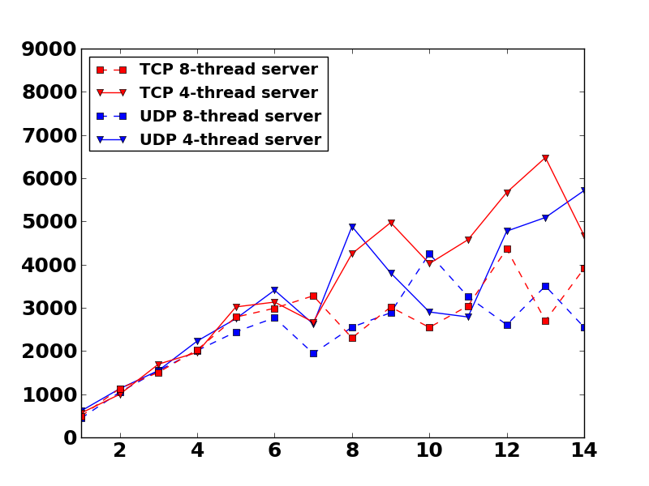
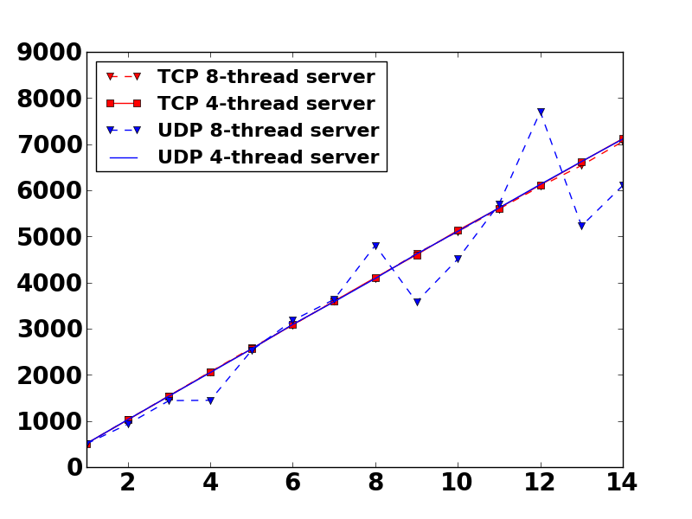
Server throughput at heavy load
DIABLO
Measured
KB/s
# of clients
# of clients
Simulated servers encounter performance bottleneck after 6 clients
  More server threads does not help when server is loaded
Simulation still reproduce the trend

Slide 53
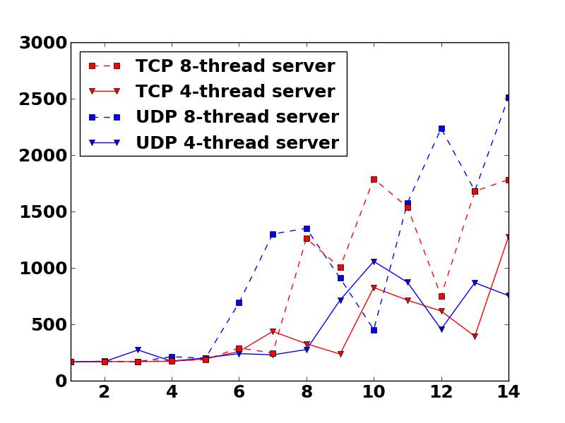
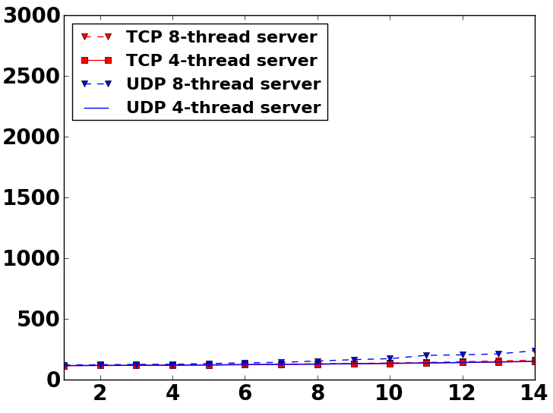
Client latencies – heavy load
DIABLO
Real Cluster
Microsecond
# of clients
# of clients
Simulation: significant high latency when server is saturated
Trend still captured but amplified because of CPU spec
  8-server threads have more overhead

Slide 54
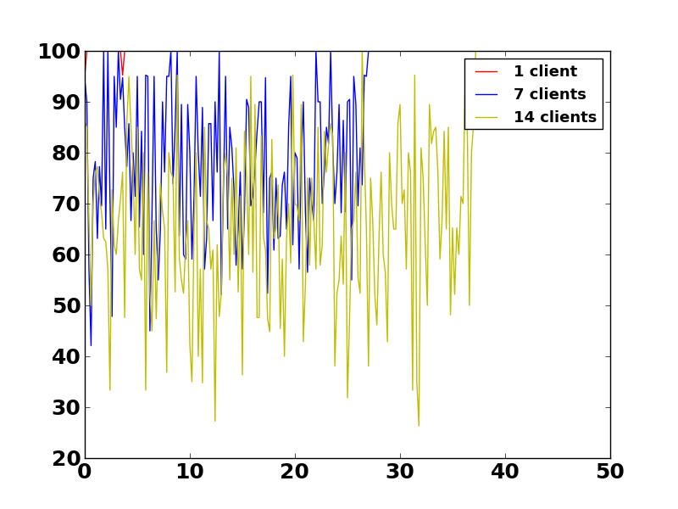
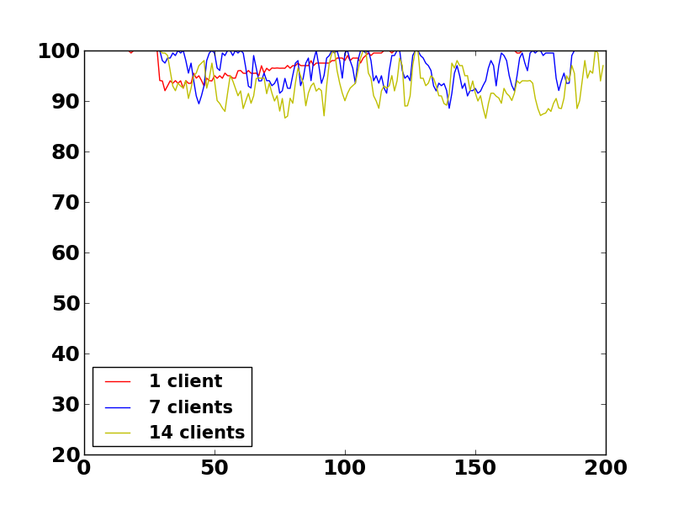
Memcached is a kernel-CPU intensive app
DIABLO
Real Cluster
%
second
second
Memcached spent a lot of time in the kernel!
  Matches results from other work: “Thin Servers with Smart Pipes: Designing SoC Accelerators for Memcached” ISCA 2013
  We need to simulate OS and computation!

Slide 55
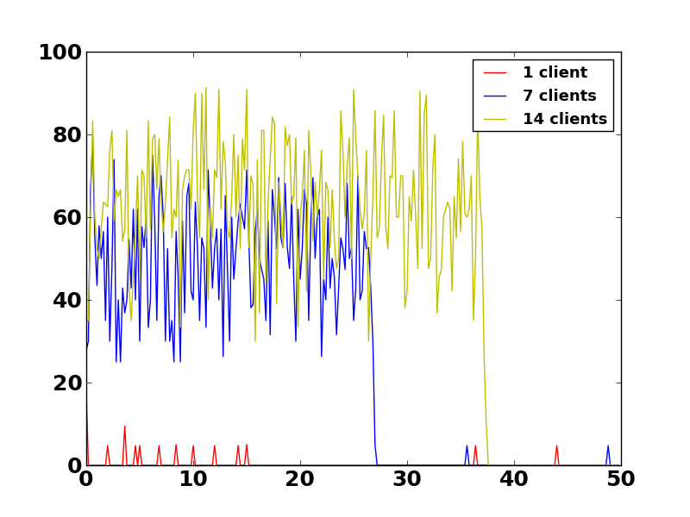
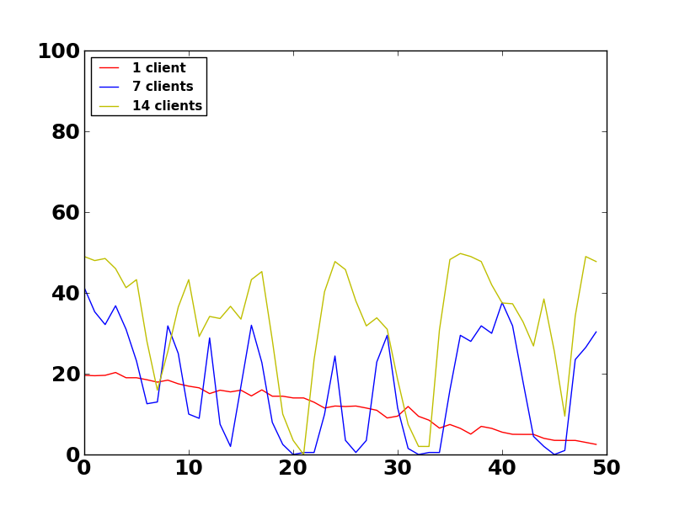
Server CPU utilizations at heavy load
DIABLO
Real Cluster
%
second
second
Simulated servers are less powerful than the validation testbed, but relative numbers are good

Slide 56
Compare to existing approaches
Prototyping
Software timing simulation
Virtual machine + NetFPGA
EC2 functional simulation
FAME: Simulate O(100) seconds with reasonable amount of time

Slide 57
RAMP Gold : A full-system manycore emulator
Leverage RAMP FPGA emulation infrastructure to build prototypes of proposed architectural features
  Full 32-bit SPARC v8 ISA support, including FP, traps and MMU.
  Use abstract models with enough detail, but fast enough to run real apps/OS
  Provide cycle-level accuracy
  Cost-efficient: hundreds of nodes plus switches on a single FPGA
Simulation Terminology in RAMP Gold
  Target vs. Host
    Target: The system/architecture simulated by RAMP Gold, e.g. servers and switches
    Host : The platform the simulator itself is running, i.e. FPGAs
  Functional model and timing model
    Functional: compute instruction result, forward/route packet
    Timing: CPI, packet processing and routing time

Slide 58
RAMP Gold Performance vs Simics
PARSEC parallel benchmarks running on a research OS
269x faster than full system simulator for a 64-core multiprocessor target

Slide 59
Some early feedbacks on datacenter network evaluations
Have you thought about statistical workload generator?
Why don’t you just use event-based network simulator (e.g. ns-2)?
We use micro-benchmarks, because real-life applications could not drive our switch to full.
We implement our design in small scale and run production software. That’s the only believable way.
FPGAs are too slow. The machines you modeled are not x86
We have a 20,000-node shared cluster for testing.

Slide 60
Novel Datacenter Network Architecture
R. N. Mysore and et al. “PortLand: A Scalable Fault-Tolerant Layer 2 Data Center Network Fabric”, SIGCOMM 2009, Barcelona, Spain
A. Greenberg and et al. “VL2: A Scalable and Flexible Data Center Network”, SIGCOMM 2009, Barcelona, Spain
C. Guo and et al. “BCube: A High Performance, Server-centric Network Architecture for Modular Data Centers”, SIGCOMM 2009, Barcelona, Spain
A. Tavakoli and et al, “Applying NOX to the Datacenter”, HotNets-VIII, Oct 2009
D. Joseph, A. Tavakoli, I. Stoica, A Policy-Aware Switching Layer for Data Centers, SIGCOMM 2008 Seattle, WA
M. Al-Fares, A. Loukissas, A. Vahdat, A Scalable, “Commodity Data Center Network Architecture”, SIGCOMM 2008 Seattle, WA
C. Guo and et al., “DCell: A Scalable and Fault-Tolerant Network Structure for Data Centers”, SIGCOMM 2008 Seattle, WA
The OpenFlow Switch Consortium, www.openflowswitch.org
N. Farrington and et al. “Data Center Switch Architecture in the Age of Merchant Silicon”, IEEE Symposium on Hot Interconnects, 2009

Slide 61
Software Architecture Simulation
Full-system software simulators for timing simulation
  N. L. Binkert and et al., “The M5 Simulator: Modeling Networked Systems”, IEEE Micro, vol. 26, no. 4, July/August, 2006
  P. S. Magnusson, “Simics: A Full System Simulation Platform. IEEE Computer”, 35, 2002.
Multiprocessor parallel software architecture simulators
  S. K. Reinhardt and et al. “The Wisconsin Wind Tunnel: virtual prototyping of parallel computers. SIGMETRICS Perform. Eval. Rev., 21(1):48–60, 1993”
  J. E. Miller and et al. “Graphite: A Distributed Parallel Simulator for Multicores”, HPCA-10, 2010
Other network and system simulators
  The Network Simulator - ns-2, www.isi.edu/nsnam/ns/
  D. Gupta and et al. “DieCast: Testing Distributed Systems with an Accurate Scale Model”, NSDI’08, San Francisco, CA 2008
  D. Gupta and et al. “To Infinity and Beyond: Time-Warped Network Emulation” , NSDI’06, San Jose, CA 2006

Slide 62
RAMP related simulators for multiprocessors
Multithreaded functional simulation
  E. S. Chung and et al. “ProtoFlex: Towards Scalable, Full-System Multiprocessor Simulations Using FPGAs”, ACM Trans. Reconfigurable Technol. Syst., 2009
Decoupled functional/timing model
  D. Chiou and et al. “FPGA-Accelerated Simulation Technologies (FAST): Fast, Full-System, Cycle-Accurate Simulators”, MICRO’07
  N. Dave and et al. “Implementing a Functional/Timing Partitioned Microprocessor Simulator with an FPGA”, WARP workshop ‘06.
FPGA prototyping with limited timing parameters
  A. Krasnov and et al. “RAMP Blue: A Message-Passing Manycore System In FPGAs”, Field Programmable Logic and Applications (FPL), 2007
  M. Wehner and et al. “Towards Ultra-High Resolution Models of Climate and Weather”, International Journal of High Performance Computing Applications, 22(2), 2008

Slide 63
General Datacenter Network Research
Chuck Thacker, “Rethinking data centers”, Oct 2007
James Hamilton, “Data Center Networks Are in my Way”, Clean Slate CTO Summit, Stanford, CA Oct 2009.
Albert Greenberg, James Hamilton, David A. Maltz, Parveen Patel, “The Cost of a Cloud: Research Problems in Data Center Networks”, ACM SIGCOMM Computer Communications Review, Feb. 2009
James Hamilton, “Internet-Scale Service Infrastructure Efficiency”, Keynote, ISCA 2009, June, Austin, TX

Slide 64
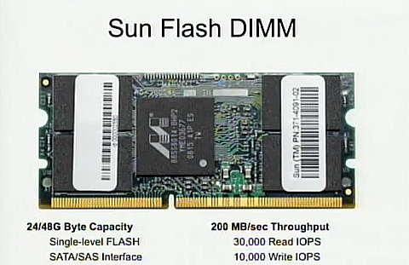
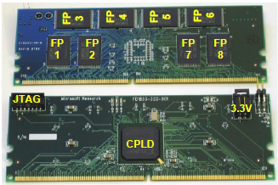
Memory capacity
Hadoop benchmark memory footprint
  Typical configuration: JVM allocate ~200 MB per node
Share memory pages across simulated servers
Use Flash DIMMs as extended memory
  Sun Flash DIMM : 50 GB
  BEE3 Flash DIMM : 32 GB DRAM Cache + 256 GB SLC Flash
Use SSD as extended memory
  1 TB @ $2000, 200us write latency
BEE3 Flash DIMM

Slide 65
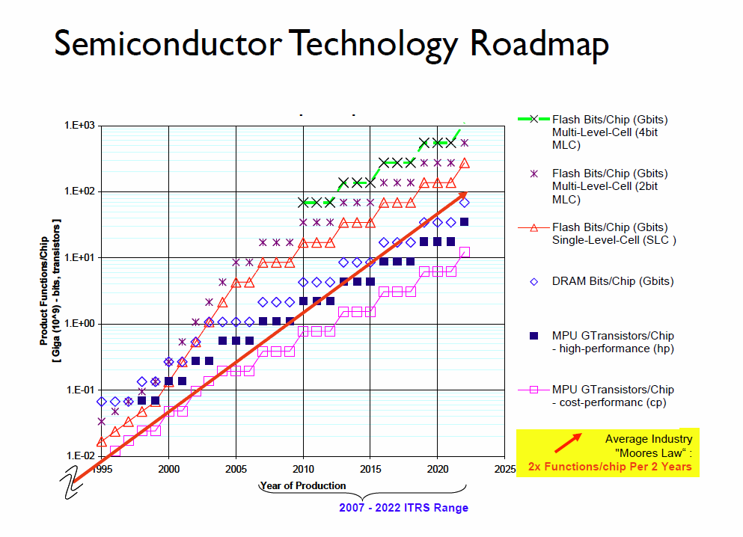

Slide 66
OpenFlow switch support
The key is to simulate 1K-4K TCAM flow tables/port
  Fully associative search in one cycle, similar to TLB simulation in multiprocessors
  Functional/timing split simplifies the functionality : On-chip SRAM $ + DRAM hash tables
  Flow tables are in DRAM, so can be easily updated using either HW or SW
Emulation capacity (if we only want switches)
  Single 64-port switch with 4K TCAM /port and 256KB port buffer
    Requires 24 MB DRAM
  ~100 switches/one BEE3 FPGA, ~400 switches/board
    Limited by the SRAM $ of TCAM flow tables

Slide 67
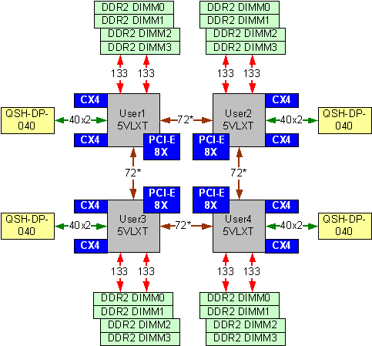
BEE3

Slide 68
  How did people do evaluation recently?
Novel Architectures | Evaluation | Scale/simulation time | latency | Application
Policy-away switching layer | Click software router | Single switch | Software | Microbenchmark
DCell | Testbed with exising HW | ~20 nodes / 4500 sec | 1 Gbps | Synthetic workload
Portland (v1) | Click software router + exiting switch HW | 20 switches and 16 end hosts (36 VMs on 10 physical machines) | 1 Gbps | Microbenchmark
Portland (v2) | Testbed with exising HW + NetFPGA | 20 Openflow switches and 16 end-hosts / 50 sec | 1 Gbps | Synthetic workload + VM migration
BCube | Testbed with exising HW + NetFPGA | 16 hosts + 8 switches /350 sec | 1 Gbps | Microbenchmark
VL2 | Testbed with existing HW | 80 hosts + 10 switches / 600 sec | 1 Gbps + 10 Gbps | Microbenchmark
Chuck Thack’s Container network | Prototyping with BEE3 | - | 1 Gbps + 10 Gbps | Traces
Notes:
backup

